Slide 1
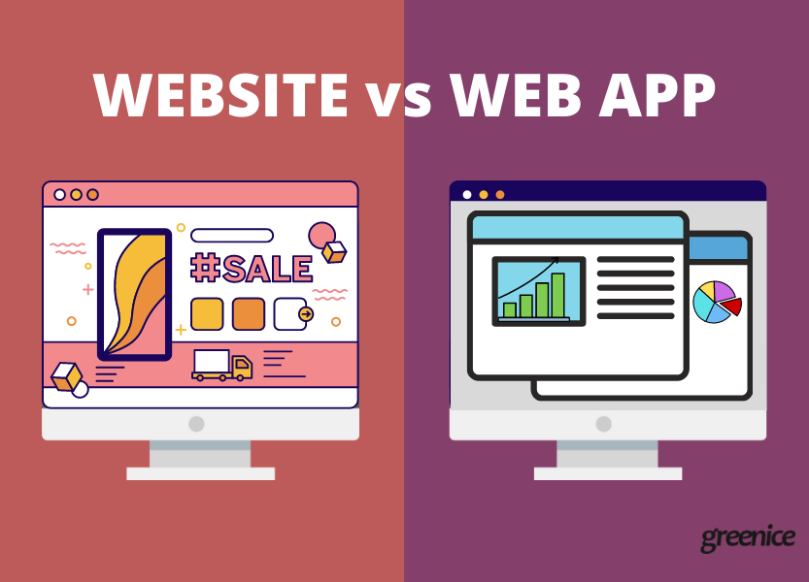
Websites and Web Apps

Slide 2
Webpage, Website and Web Apps
When you do something online, you are likely to encounter web pages, websites, and web applications.
But how do they differ? As a developer, how do you decide which one to create?
Let's explore the main features of each one.

Slide 3
Webpage, Website and Web Apps
A typical web page is one single page that consists of HTML,CSS, and JavaScript.
It displays images, text, videos, and other content in the web browser.
If a web page is one single page then a website is a collection of webpages that link together under one domain name.
You've likely visited many websites this week.

Slide 4
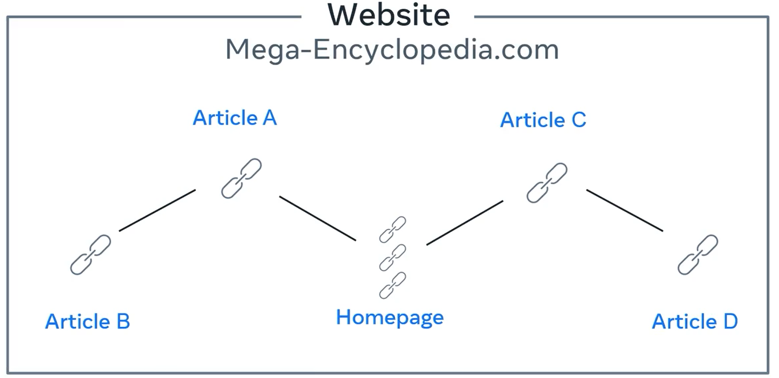
Webpage, Website and Web Apps
You know, when you visit your favorite encyclopedia website and the homepage has a lot of links to different articles, clicking on one of those links brings you to an article on a new web page, and that article links to more articles, and other web pages.
Well, since all of these web pages exist
under the same domain name, they
are a website.

Slide 5
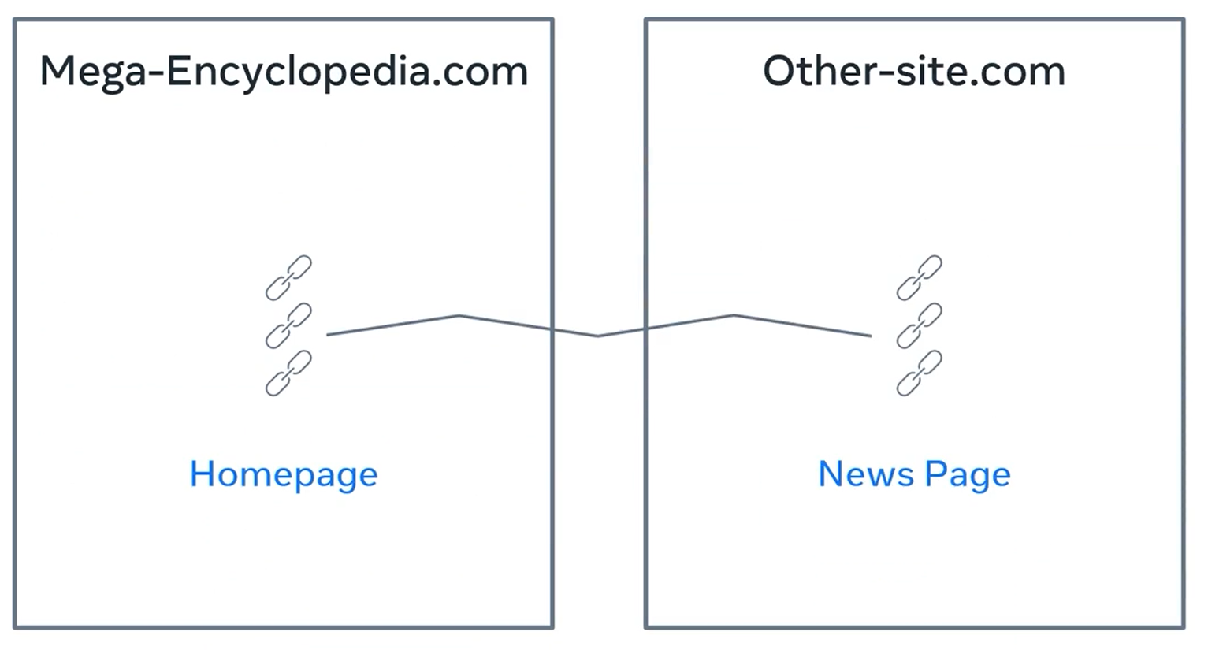
Webpage, Website and Web Apps
The technical term for a link, you click on a hyperlink.
This is because they link to hypertext content. Remember that HTML is Hypertext Markup Language.
However, links themselves, don't have to link to the same website. They can also link to other websites.

Slide 6
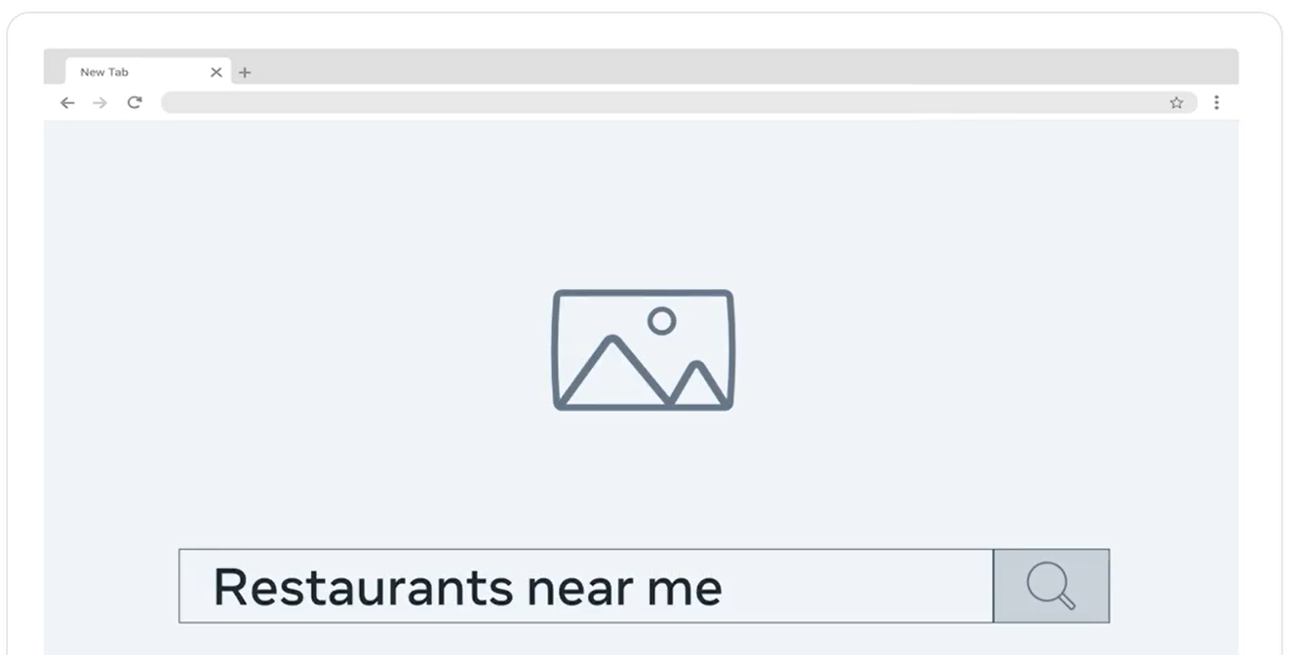
Webpage, Website and Web Apps
For example when you go to your favorite search engine and search for a phrase, the search results are a list of links to other websites.
You'll explore more about hyperlinks later.

Slide 7
Webpage, Website and Web Apps
By now, you should probably know the difference between a web page and the websites, but what about a web application?
This is where the definitions gets a little more blurred.
The terms website and web application are often used interchangeably.

Slide 8
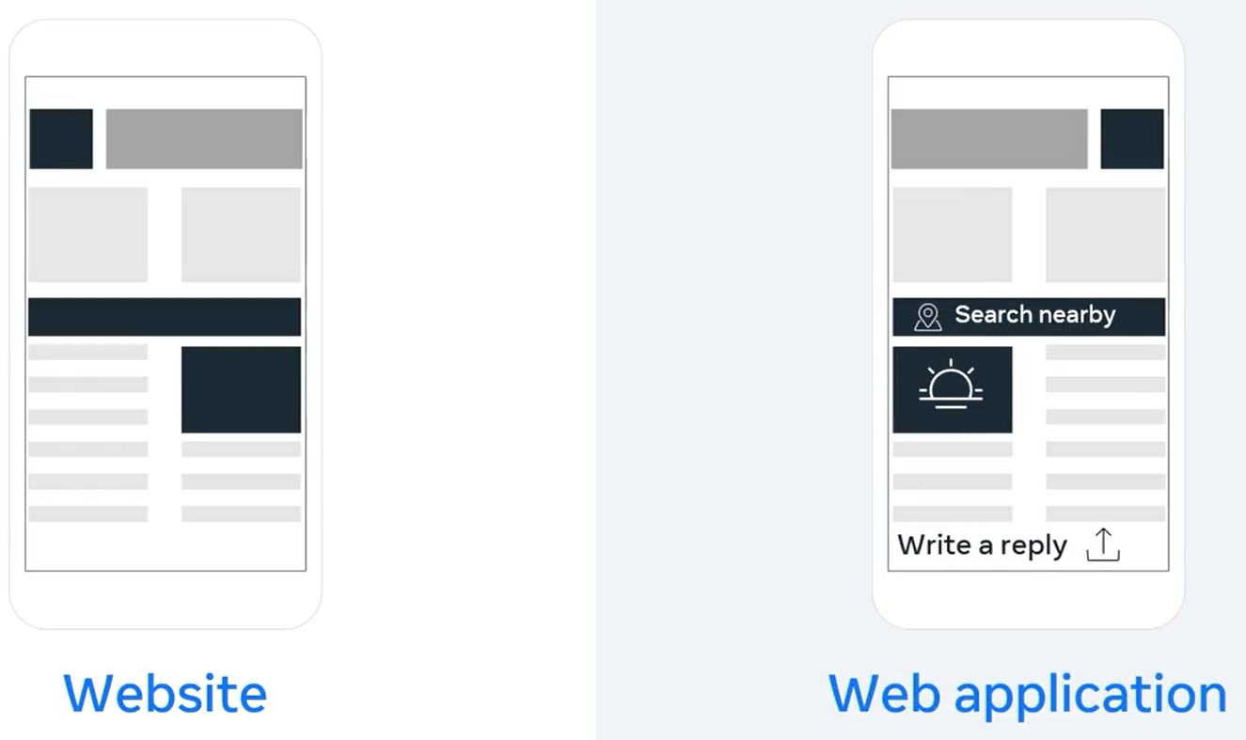
Webpage, Website and Web Apps
The key difference between a website, and web application is the level of interactivity, and dynamic content.
The easy way to remember this is that:
  a website is more informative and
  a web application is more interactive.

Slide 9
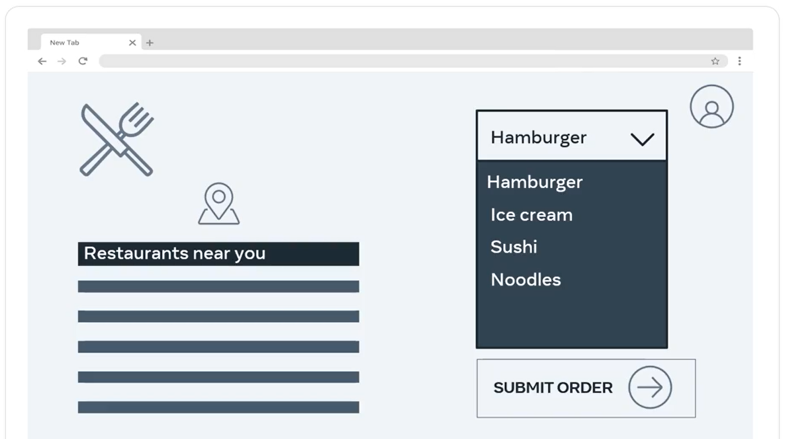
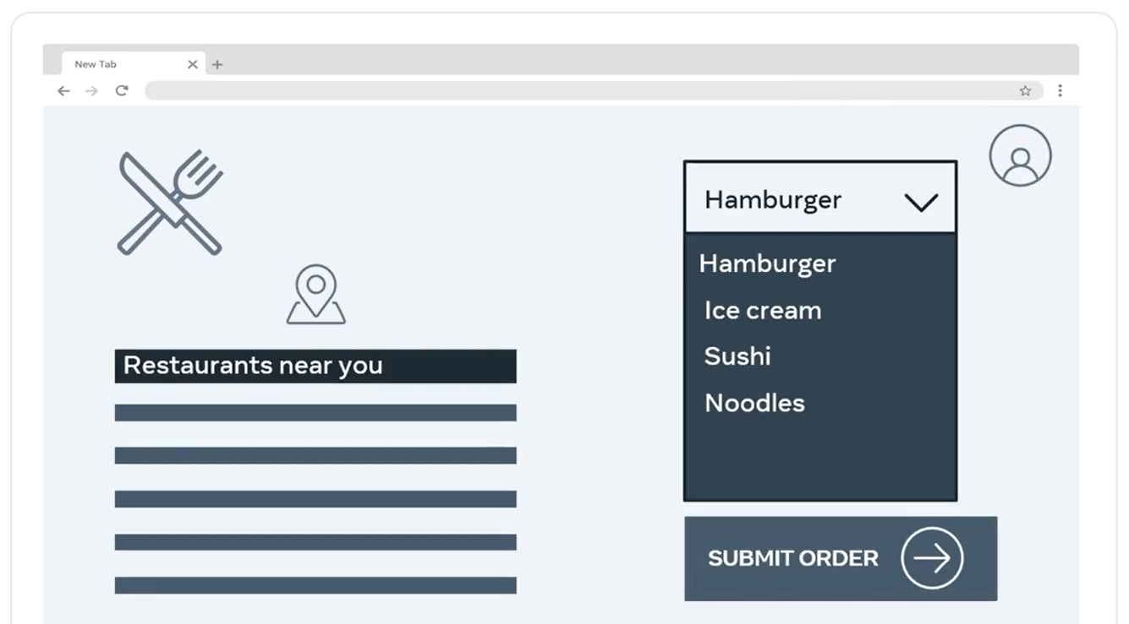
Webpage, Website and Web Apps
Think of ordering food online. Let's say you would like to order some food and you go to your favorite site, the browser then displays a web page, you select some food from the menu and submit your order.

Slide 10
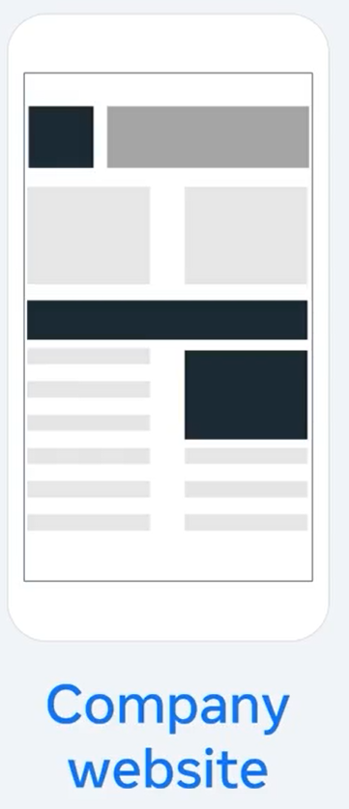
Webpage, Website and Web Apps
Compare this to for example, a company website that displays information about themselves and the services they provide.

Slide 11
Webpage, Website and Web Apps
In the food ordering example, the content displayed is specific to your user account and location, the web application displays content based on the user's input and interaction.

Slide 12
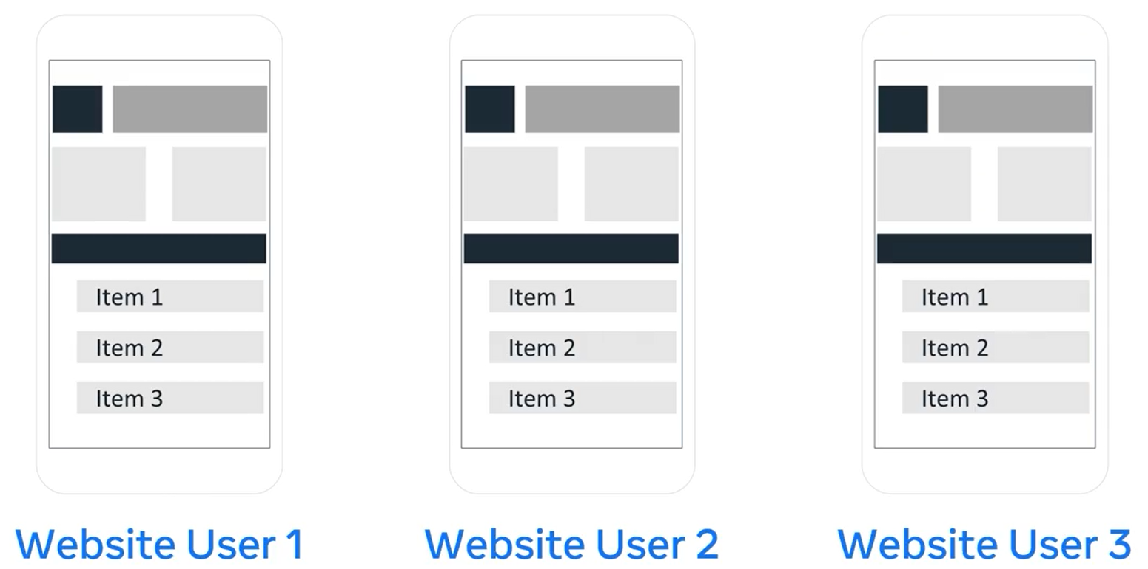
Webpage, Website and Web Apps
Whereas with the company website, the user simply views the content and this content is the same for everyone who visits the website.

Slide 13
Summary
You should now be able to distinguish between web pages, websites, and web applications.
You know that web pages at a particular domain make up a website, and that the key difference between websites, and web applications is the level of interactivity, and dynamic content.

Slide 14
Additional Resources
Learn more Here is a list of resources that may be helpful as you continue your learning journey.
HTTP Overview (Mozilla)
https://developer.mozilla.org/en-US/docs/Web/HTTP/Overview
Introduction to Networking by Dr.Charles R Severance
https://www.amazon.com/Introduction-Networking-How-Internet-Works/dp/1511654945/
Chrome Developer Tools Overview (Google)
https://developer.chrome.com/docs/devtools/overview/
Firefox Developer Tools User Docs (Mozilla)
https://firefox-source-docs.mozilla.org/devtools-user/index.html
Getting Started with Visual Studio Code (Microsoft)
https://code.visualstudio.com/docs

Slide 15
Thank You

